Slide 1
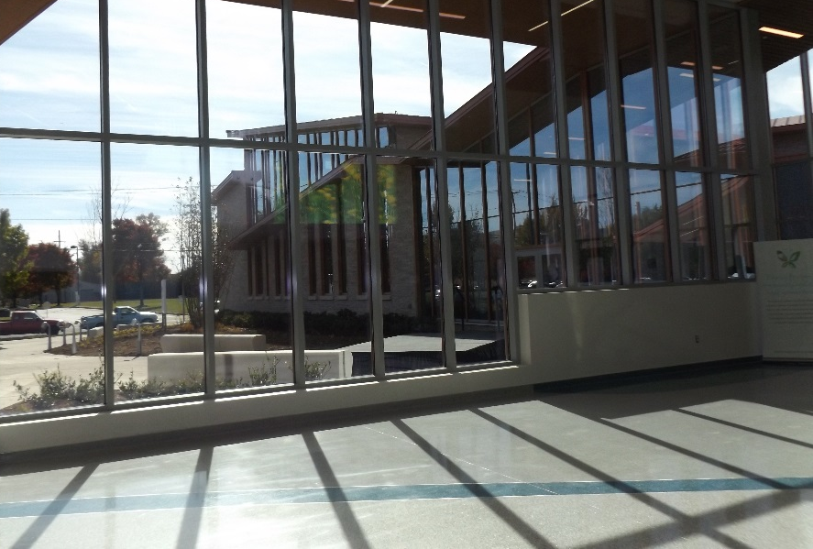
The New VTCC

Slide 2
Faculty Productivity
Peer-reviewed papers | 405
Presentations | 356
Books | 4
Editorships | 8

Slide 3
Research Rankings
NIH | 34
NIAAA | 7
NIDA | 13
Blue Ridge | 34
School of Medicine | 4

Slide 4
Psychiatry Residency
Teaching
Residents & Fellows | 60
Medical Students | 500
Clinical
Inpatient Adult | 1901 admits
Inpatient Child | 1075 admits
Outpatients | 36,000 visits
ER + C&L | 2,000 visits
Substance Abuse | 600 consults

